Slide 1
Dump the Ceremonies
Build Trust Instead
How Difficult Conversations Unlock Successful Digital, Agile, Devops, and Lean Transformations
Douglas Squirrel and Jeffrey Fredrick
Authors of Agile Conversations
DOES London—June 2020
Notes:
Title: Conversational Transformation - The Missing Foundation: How Difficult Conversations Unlock Successful Digital, Agile, Devops, and Lean Transformations
Summary:
Is your company transformation falling short of your goals? Have you bought all the books, held the trainings, followed all the practises—but you didn’t get the promised results?
If so, it is probably your fault—there are almost certainly several difficult conversations you have been avoiding that could change your results dramatically: increasing trust, reducing fear, creating an inspiring Why, encouraging commitment, and ensuring accountability. The good news is that there are proven, concrete steps you can take today to start a conversational transformation that will address these problems. We will show you how to take the first steps toward a truly human-centred technology transformation using nothing more than a sheet of paper, and point the way to further development with techniques like Test-Driven Development for People and Directed Opportunism.

Slide 2
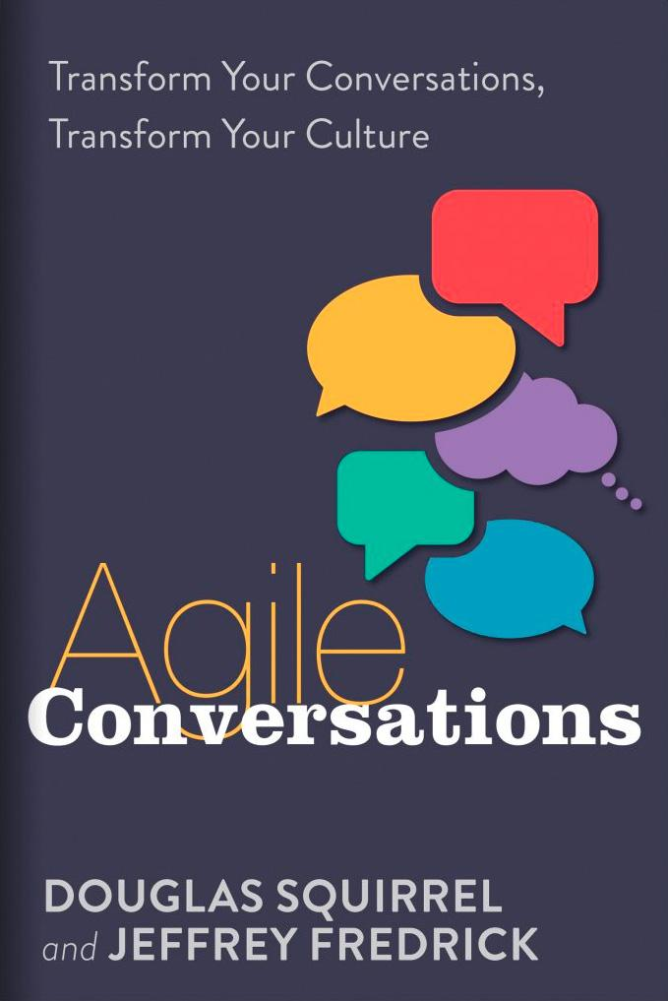
Agile Conversations Transform Your Conversations,
Transform Your Culture
Published: May 2020, IT Revolution Press
Available for Now

Slide 3
What makes transformations hard?
84% of digital transformations fail (Michael Gale, author of The Digital Helix)
Success required a “fundamental shift in how people had to think about how they interact, how they collaborate and work, and if you don’t spend time changing people’s behaviors, you don’t spend time changing culture and how people make decisions, all of this falls flat.”
Transformation advice says what bad and good look like... but not how to get from one to the other.

Slide 4
Westrum’s “Three Cultures”
Pathological
Preoccupied with “personal power, needs, and glory”
Bureaucratic
Preoccupied with “rules, positions, and departmental turf”
Generative
Concentration on the mission itself, as opposed to a concentration on persons or positions
https://www.ncbi.nlm.nih.gov/pmc/articles/PMC1765804/pdf/v013p0ii22.pdf
Notes:
What’s the culture we are starting with? We are probably in one of the first two, trying to get to generative

Slide 5
Three Approaches to Transformation
Pathological
Transformation directed from the top, riding roughshod over the bodies
Bureaucratic
Transformation by the book, using approved best practises, paint by
numbers
Generative
Adaptive transformation that fits organisation goals and personal needs
Notes:
Our approach to our transformation will reflect the culture we have, not the culture we want

Slide 6
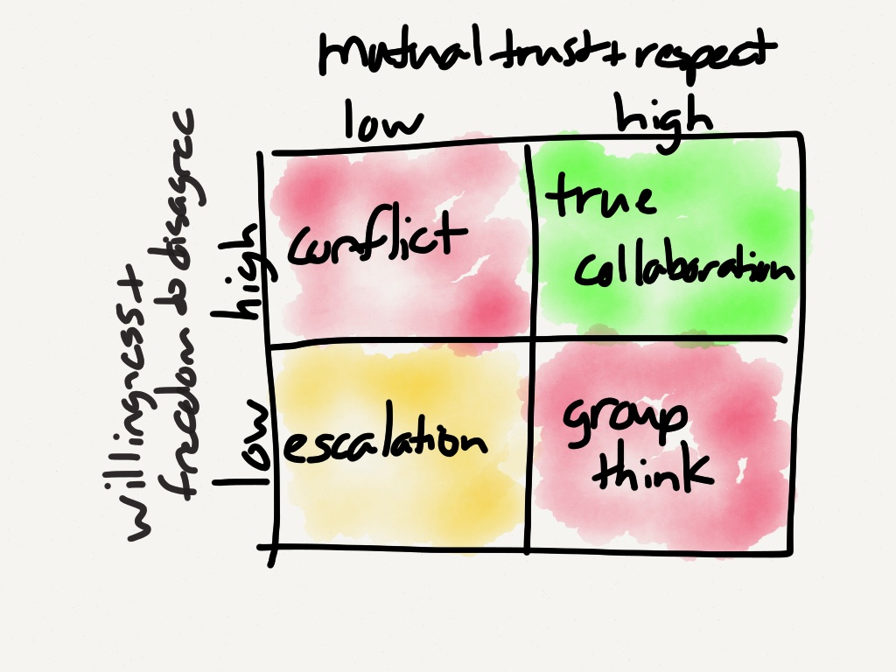
Image from The Uncanny Valley of a Functional Organization
Notes:
First dysfunction is lack of trust.
Solutions are 1. share your personal history, 2. discuss your team members’ most important strengths and weaknesses, 3. provide feedback, 4. run personality type analyses, and 5. go on a ropes course.
Squirrel was angry with Lencioni and wanted his money back.

Slide 7
Changing Your Culture
Start with a conversational transformation…
The good news is that there are tested, well-defined approaches to enabling organizational learning
Chris Argyris, Yale and Harvard professor, studied these questions
His answer (and ours) is to use conversations to become self-aware
When we change the conversations, we change the culture
This is a conversational transformation
…and you already know what the results look like!
Notes:
“And you already know” → we’ll show you why this is

Slide 8

Making an Important
Decision
Imagine you and everyone here in the Slack channel are going to make an important decision together—for instance, the location of next year’s DOES conference.
How would you propose the group make the decision?
Please type your answer in Slack.
Notes:
Options here:
Ask audience to respond (in groups if possible)
Ask individual to respond
Both
Just do ourselves, on stage

Slide 9
The Paradox of Espoused Behavior
All of you know what is required to get to a good decision:
Diversity is strength
Share ideas, facts, reasoning
Productive, collaborative conflict of ideas
And yet our actual behavior is different, especially when the stakes are high:
We want our idea to win
Differences are a threat
We don’t listen to others and don’t share all we know
Notes:
“Thanks, you already know how to make good decisions! We’ll cancel the book.”
Point out the theory-in-use is inconsistent with a generative culture

Slide 10
The Four Rs
Notes:
12:00 time check

Slide 11
Conversational Analysis with The 4 Rs
1 | Record
2 | Reflect
3.1 | Repeat
3 | Revise
4 | Roleplay
4.1 | Role-reversal
Notes:
Point out humorously that there are six Rs in the four Rs

Slide 12
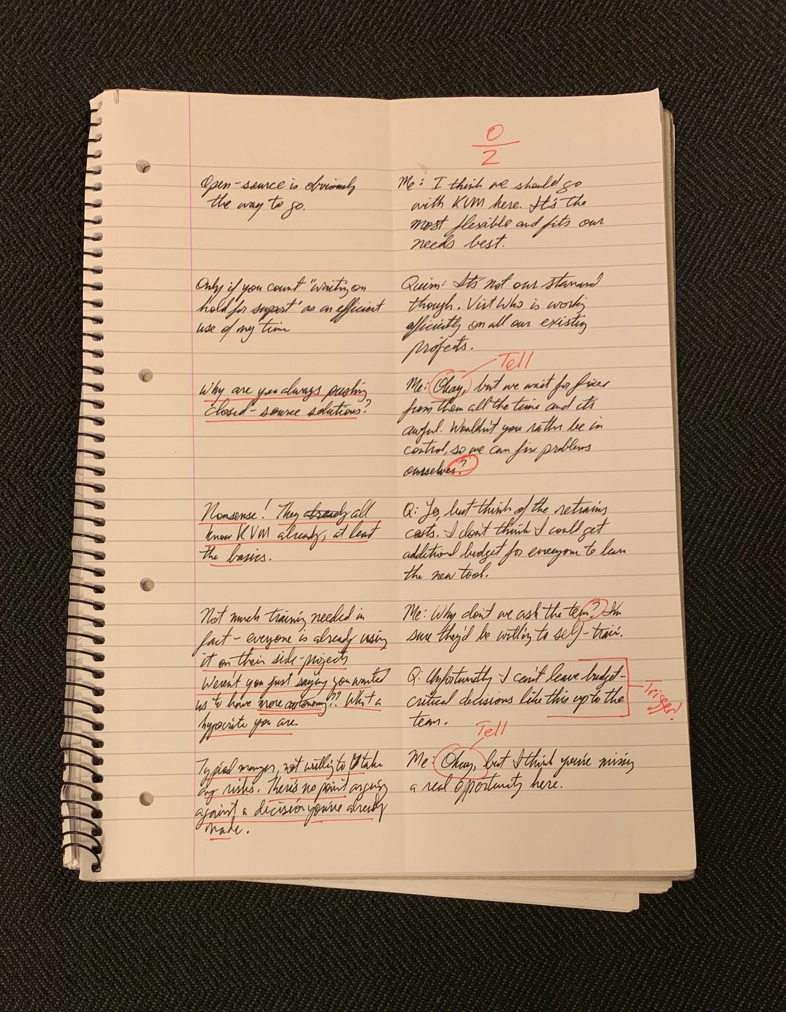
Record
Fold your paper in half.
On right, write what you and the other person said (transparency).
On left, write your inner dialog, what you thought and felt (curiosity).
No cheating, must be written down!
Notes:
Any telepaths in the room can write the other person’s thoughts. Others have to stick with their own.

Slide 13
Reflect
What Norbert thought and felt | What Norbert & Quinn said
Not much training needed in fact - everyone’s already using it on their side projects. | Norbert: Why don’t we ask the team about KVM? I’m sure they’d be willing to self-train.
Weren’t you just saying you wanted us to have more autonomy?? What a hypocrite you are. | Quinn: Unfortunately I can’t leave budget-critical decisions like this up to the team.
Typical manager, not willing to take any risks. There’s no point arguing against a decision that you’ve already made. | Norbert: Okay, but I think you’re missing a real opportunity here.
Curiosity: Look for questions - are they genuine?
Transparency: What is on the left that could be on the right?
Triggers: What sets off a negative reaction for you?
Notes:
Benjamin Mitchell story about shouting at the tape recorder
Can be emotionally challenging. The way forward is acceptance. Need to accept your mistakes if you want change them; “death of the ego”. “I made a mistake”, not “I’m a bad person”.
Book has more detailed steps including scoring. Lots of examples and a “cheat sheet”.

Slide 14
Revise
What Norbert thought and felt | What Norbert & Quinn said
Not much training needed in fact - everyone’s already using it on their side projects. | Norbert: Actually, almost everyone already knows KVM. I can check with them to be sure. Do you think that’s a good next step?
Weren’t you just saying you wanted us to have more autonomy?? This is one of my triggers, so I’ll try raising the issue of autonomy directly. | Quinn: It’s certainly good to get the information. But don’t let them think the choice has been made; unfortunately, I can’t leave budget-critical decisions like this up to the team.
I’m hopeful that we can have a meaningful discussion about increasing self-organization. | Norbert: You know, that doesn’t sit well with me, because I think we need more autonomy, not less. Can we talk more about how we make decisions?
Notes:
Genuine questions
Begin to learn how to say things previously left unsaid - autonomy in right hand column.
A chance to create pre-planned actions

Slide 15

Roleplay
Try roleplaying your conversation.
How does it sound? How does it feel? Sometimes it is awkward because it is poorly constructed, sometimes it is awkward because we lack practice. Roleplay can help with both.
Notes:
Options:
Audience roleplays with partner
Individual roleplays with us
Both
Us, on stage
Role-reversal: how to is sound & feel when someone says it to you? We gain different insights hearing someone else say the same thing. (Self-distancing again)

Slide 16
What’s the Outcome?
Improved relationships
Improved trust
Better decisions
Better leadership
Takes as long as learning to play a passable game of tennis.
You practice with your everyday work, solving everyday problems.

Slide 17
The Five Conversations
Each conversation comes with techniques, examples, and case studies
Trust - TDD for People (Chris Argyris, The Ladder of Inference)
Fear - Fear Chart (Squirrel/Fredrick)
Why - Joint Design (Chris Argyris)
Commitment - Walking Skeleton (Alistair Cockburn)
Accountability - Briefing and Back Briefing (Bungay, Art of Action)
We want you to try these methods, tell us how it helped, and where you get stuck.
Notes:
This talk covered only Chapter 2 -- the rest of the book is an instruction manual for using the 4 Rs in your (agile/devops/lean) team

Slide 18
Agile Conversations Transform Your Conversations,
Transform Your Culture
Published: May 2020, IT Revolution Press
Available for Now

Slide 19

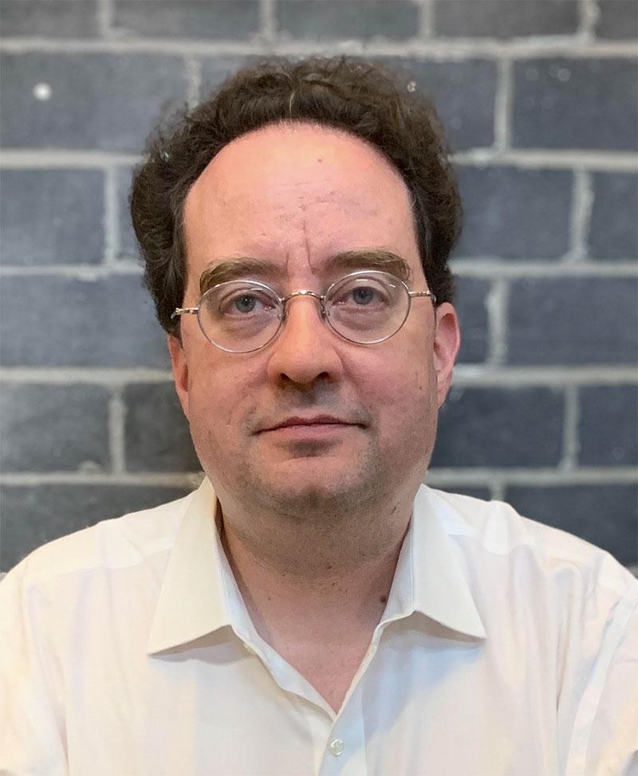

Questions?
http://conversationaltransformation.com
Newsletter : Personalised Advice : Training Workshops
Guided Transformation
Troubleshooting Agile podcast at http://troubleshootingagile.com

